Slide 1
Real Autobots and Decepticons
Programming a Self-Configuring Robot
Notes:
Carter

Slide 2
Project Overview
Notes:
Ben

Slide 3
Problem Statement
Unaided organization of modules into a predetermined formation from random starting points.
Notes:
Ben

Slide 4
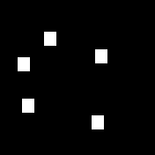
Problem Statement
Notes:
Ben

Slide 5

Problem Statement
Notes:
Ben

Slide 6
Project Status
Notes:
Trevor Seitz

Slide 7
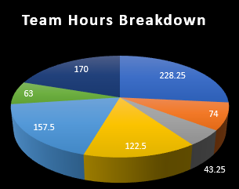
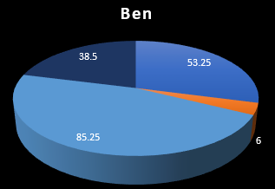
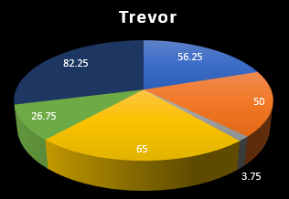
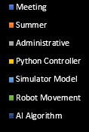
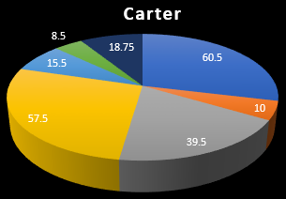
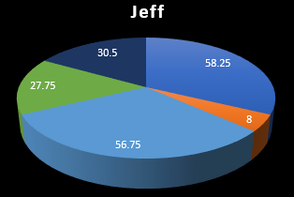
Notes:
Trevor Seitz

Slide 8
Requirements
Robot Movement (~90% Done)
Simulator Model (~100% Done)
Python Controller (~100% Done)
AI Algorithms (~40%)
Localization Algorithm (~70% Done)
Pathfinding Algorithm (~10% Done)
Overall Progress (~70% Done)
Notes:
Trevor Seitz

Slide 9
Robot Movement
Completed
Remaining
Robot Command Library
API Version 1 <c s d>
API Version 2 <c m>
Calibrate Robot Motor Constants
Configure Remaining Modules
Notes:
Trevor Sietz

Slide 10
Simulator Models
Completed
Remaining
SMORE Models
Mimic SMORE API
Position/Orientation Detection
Stay in Sync with SMORES
Notes:
Jeff

Slide 11
Python Controller
Completed
Remaining
Robust COM/TCP Communication
Dynamic COM/TCP Discovery
Heartbeat Ping
Message Relay
Nothing
Notes:
Carter

Slide 12
Demo
Notes:
Carter

Slide 13
https://youtu.be/DvsLRmNb7rI
Notes:
Carter

Slide 14
Localization Algorithm
Completed
Remaining
Localization Simulator
Pitch-Yaw Correction
Combine Multiple Camera Data
Program Arduino to Communicate with Multiple Pixy Cams
Notes:
Trevor

Slide 15
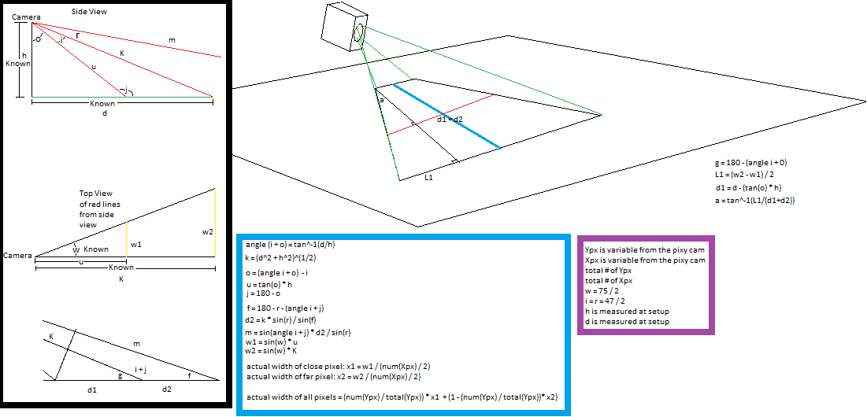
Localization Algorithm
Notes:
Trevor

Slide 16
Pathfinding Algorithm
Completed
Remaining
PDDL, first iteration
PDDL, second iteration
Convert PDDL directions into commands
Make pathfinder dynamic
Notes:
Ben

Slide 17
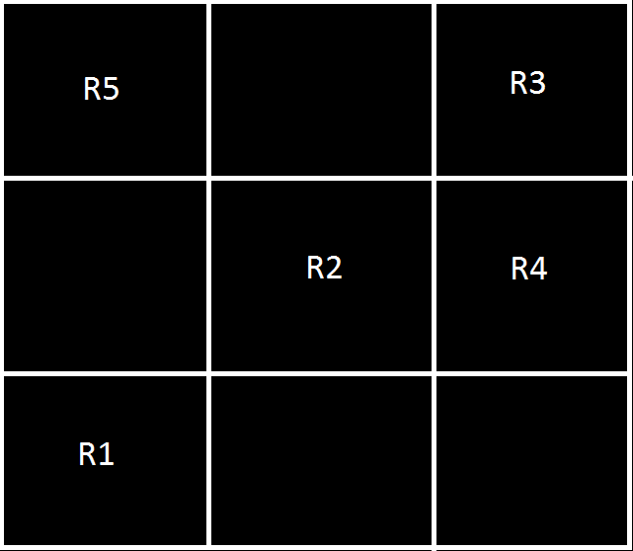
Pathfinding Algorithm
PDDL, Example
Notes:
Ben

Slide 18
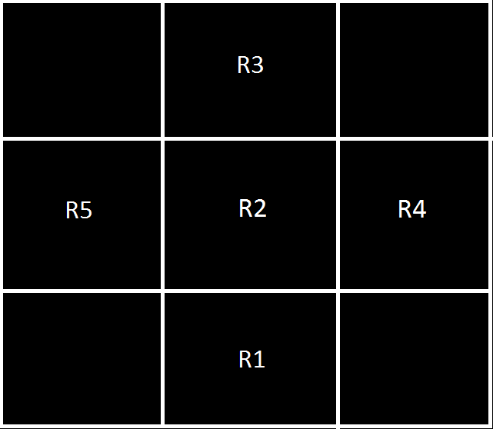
Pathfinding Algorithm
PDDL, Example
Notes:
Ben

Slide 19
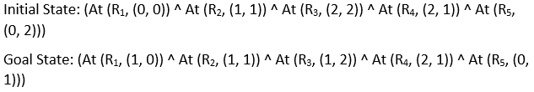
Pathfinding Algorithm
PDDL:
Initial and Goal State
Notes:
Ben

Slide 20
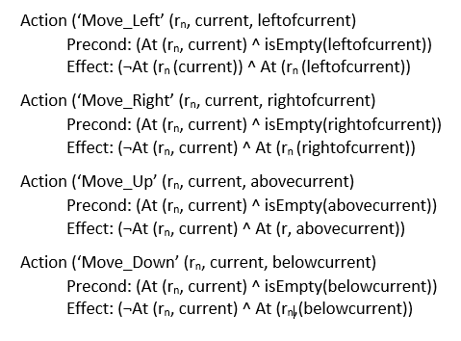
Pathfinding Algorithm
PDDL:
Actions
Notes:
Ben

Slide 21
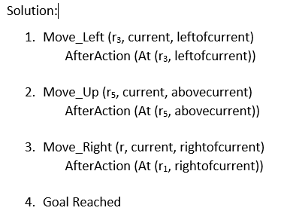
Pathfinding Algorithm
PDDL:
Solution
Notes:
Ben

Slide 22
Project Roadmap
Notes:
Jeff

Slide 23
April 4
Pathfinding Algorithm, First Iteration
Localization Complete
Notes:
Jeff

Slide 24
April 28
Final Pathfinding Algorithm
Testing Complete
Notes:
Jeff

Slide 25
Q & A
Notes:
Carter

